Slide 1
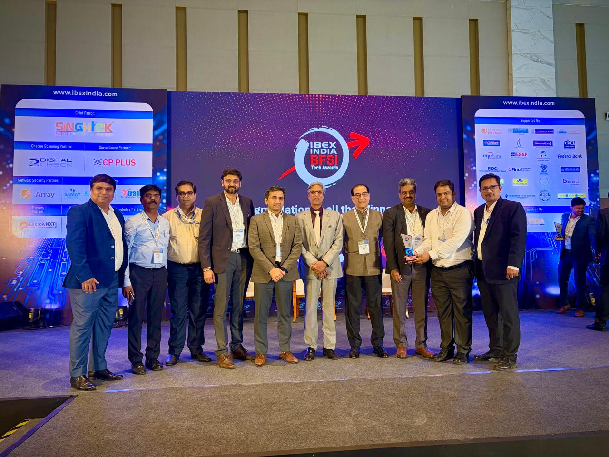
DIT
Tech Driven Operational Excellence Award – IBEX India 2026
Central Bank of India won the Tech Driven Operational Excellence Award for the Resilience Operations Centre (ROC) project in IBEX India 2026 event held on 07th April 2026 at Jio World Convention Centre, Mumbai.

Slide 2
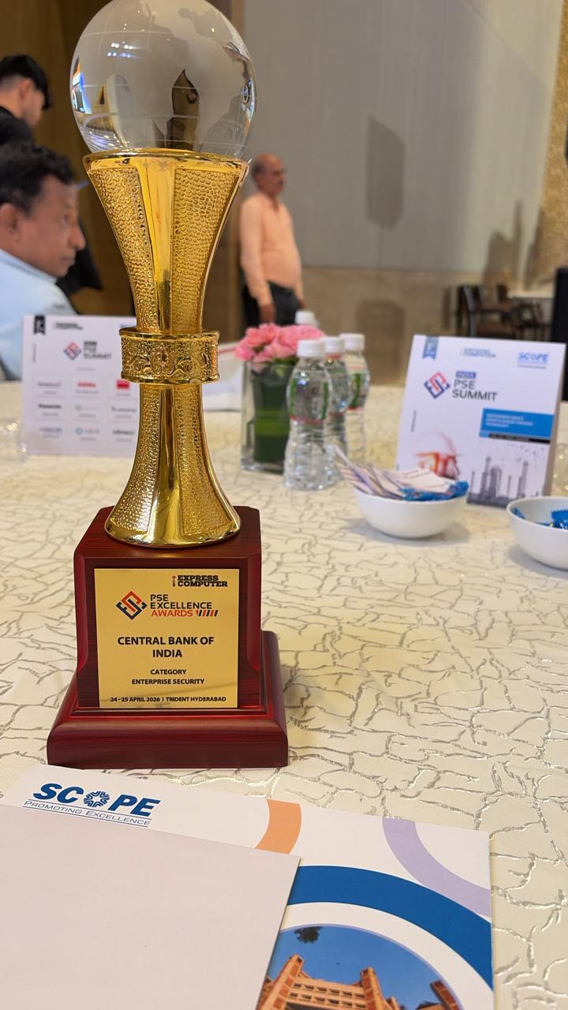
DIT
Enterprise Security- PSE Excellence Awards 2026
Central Bank of India became the winner in Enterprise Security in the PSE Excellence Awards by Express Computers on 24th April 2026 held at Trident, Hyderabad.

Slide 3
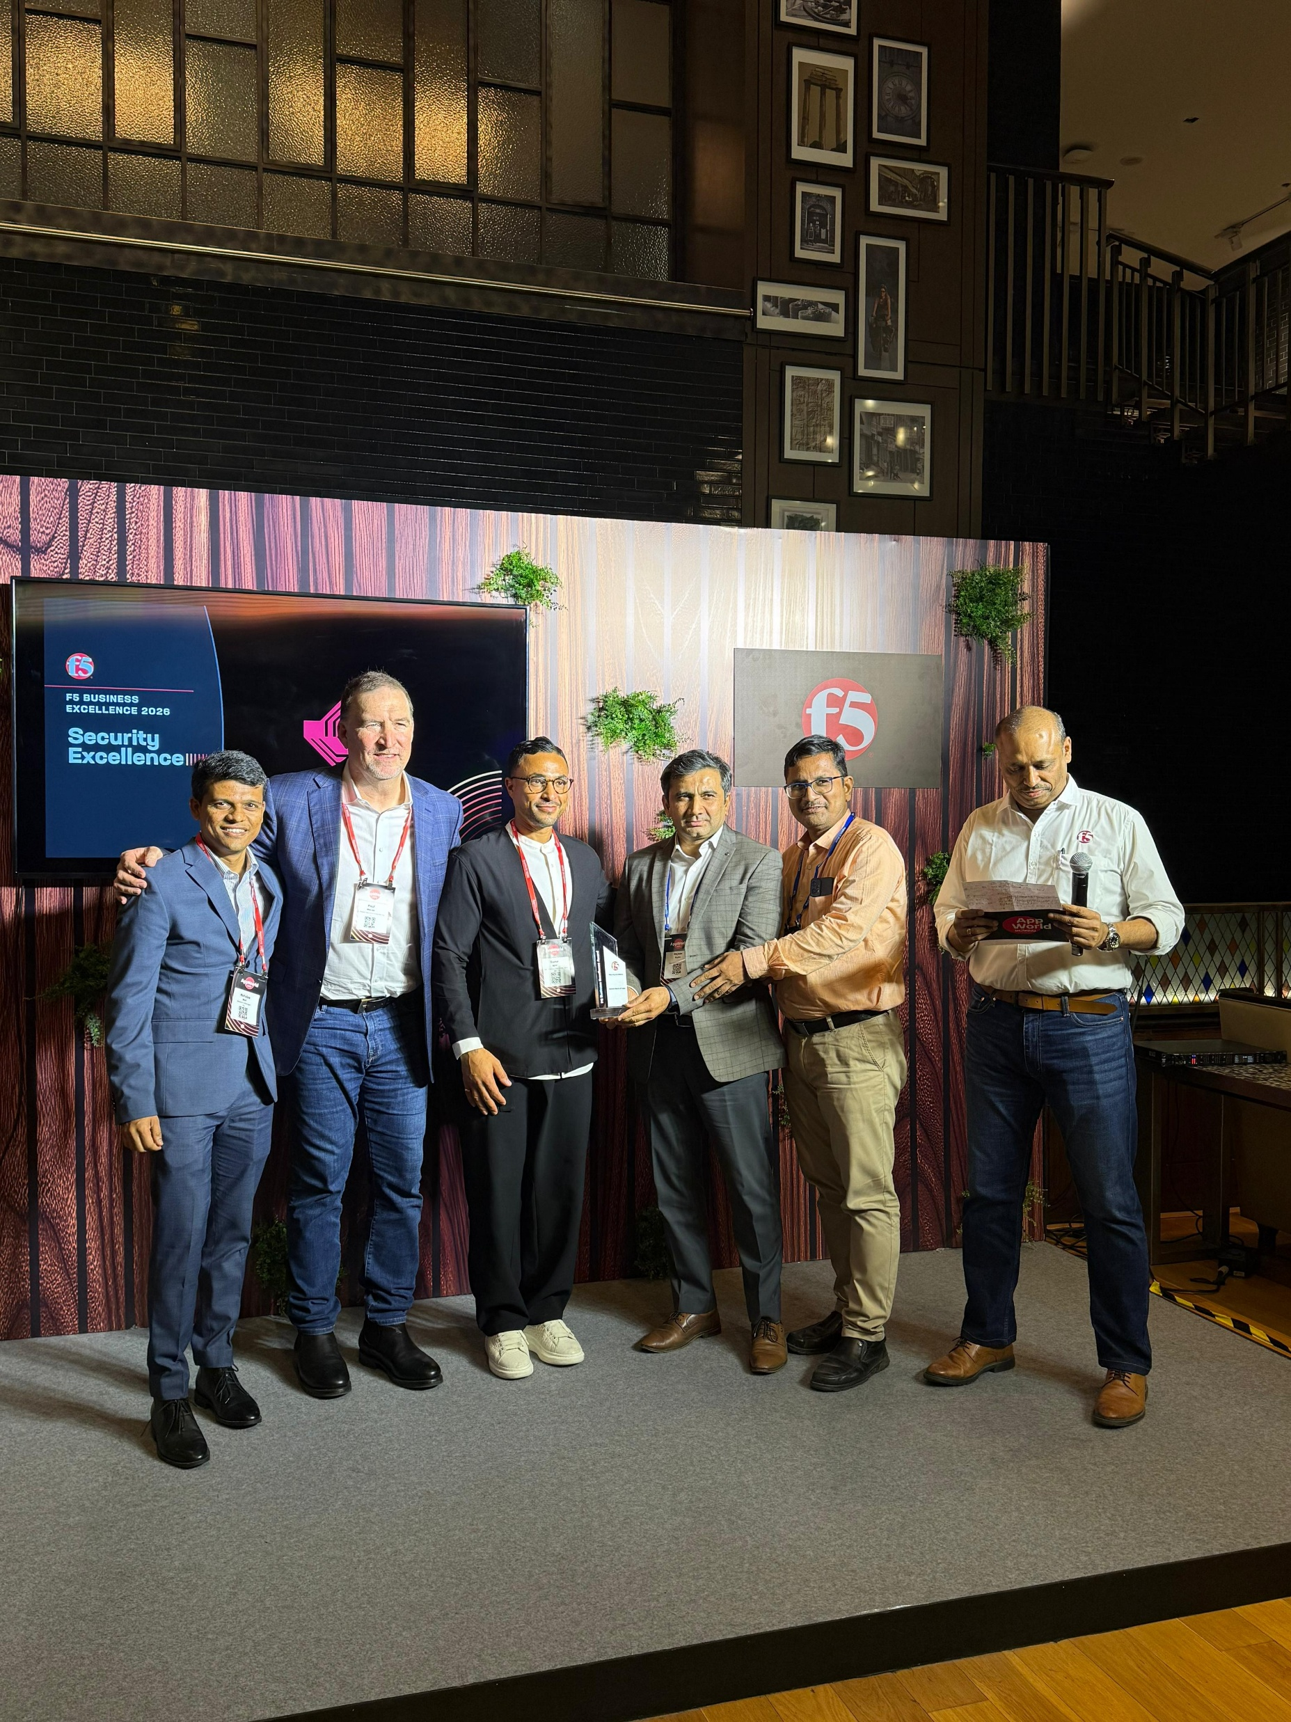
DIT
Security Excellence Award – F5 Incorporation
Central Bank of India received Security Excellence Award from F5 Incorporation to recognize innovation and technical prowess in the Cyber security and Network security on 7th May 2026 at Mumbai.

Slide 4
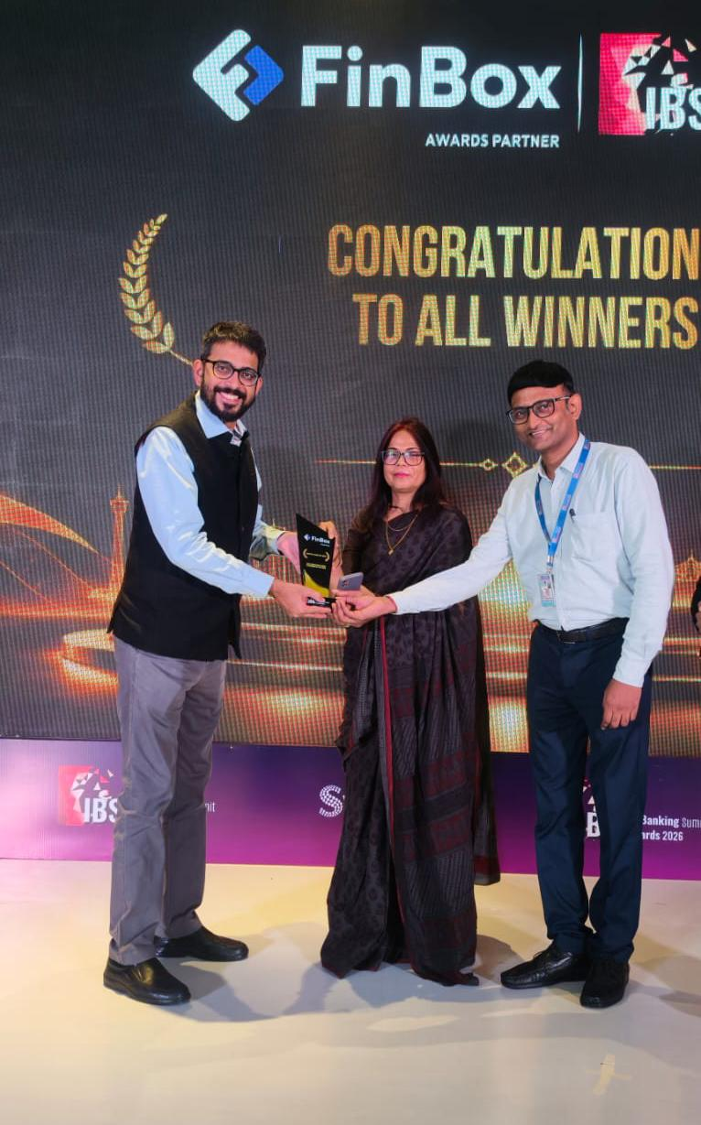
DIT
Best Innovation in User Experience of the Year Award - India Banking Summit Awards 2026
Central Bank of India won the Best Innovation in User Experience of the Year Award for the Passbook Printing Through Tab at BC points, in the India Banking Summit Awards 2026 by Synnex held on 5th June 2026 at Mumbai.

Slide 5

DIT
The Sovereignty Milestone Award – Red Hat CY26 APAC BFSI milestone Honours
Central Bank of India received the Sovereignty Milestone Award in the Red Hat CY26 APAC BFSI milestone Honours – India event held on 12th June 2026 in Mumbai.

Slide 6
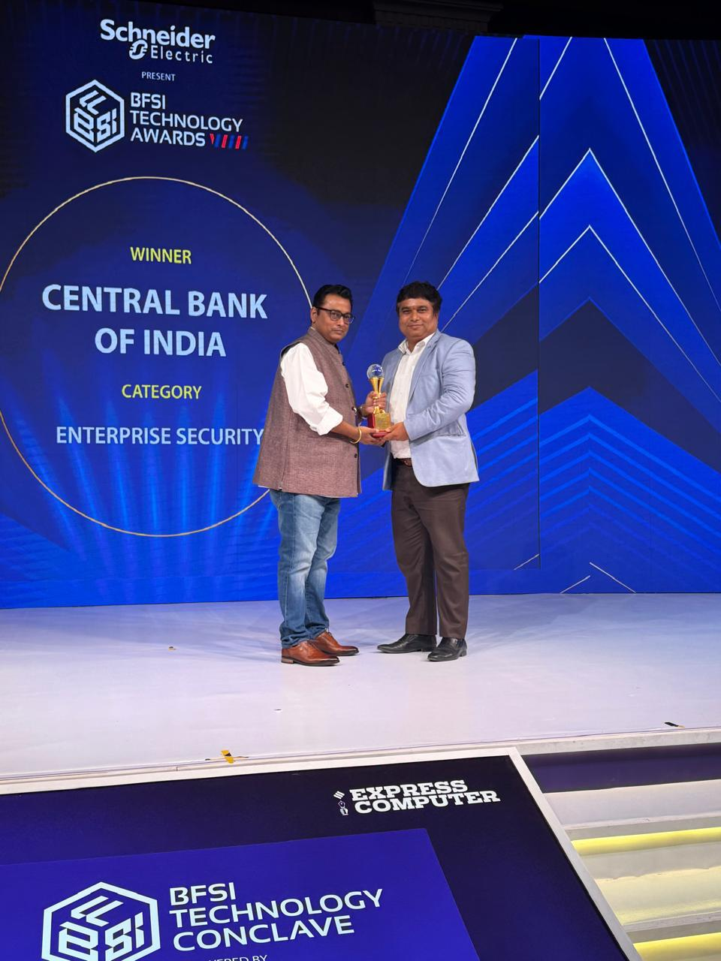
DIT
Enterprise Security Award - BFSI Technology Award 2026
Central Bank of India won the Enterprise Security Award in the BFSI Technology Award 2026 by Express Computers, held on 19th June 2026 at Raddison Blu, Karjat.

Slide 7
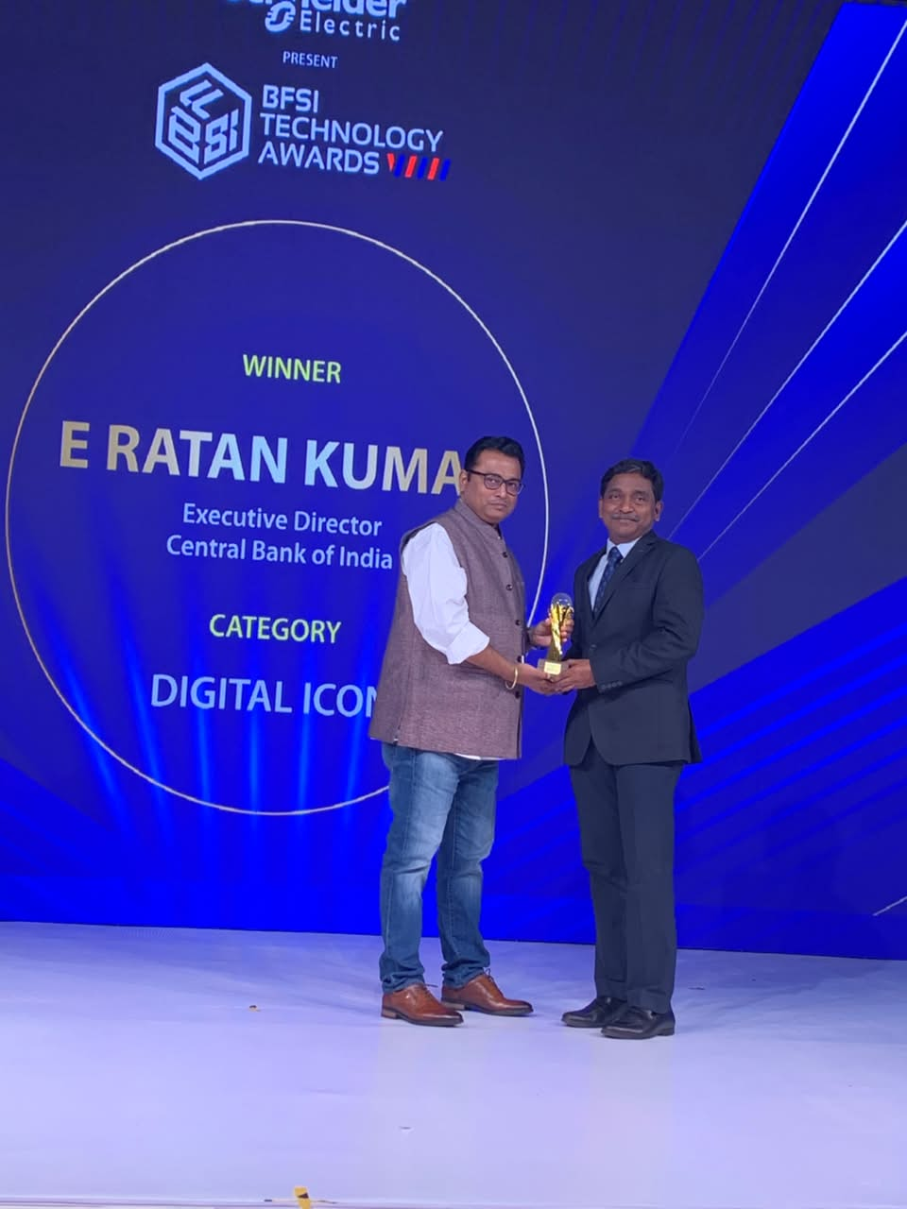
Digital Icon Award- BFSI Technology Award 2026
Shri. E Ratan Kumar, Executive Director, Central Bank of India, won the Digital Icon Award in the BFSI Technology Award 2026 by Express Computers, held on 19th June 2026 at Raddison Blu, Karjat.

